Slide 1

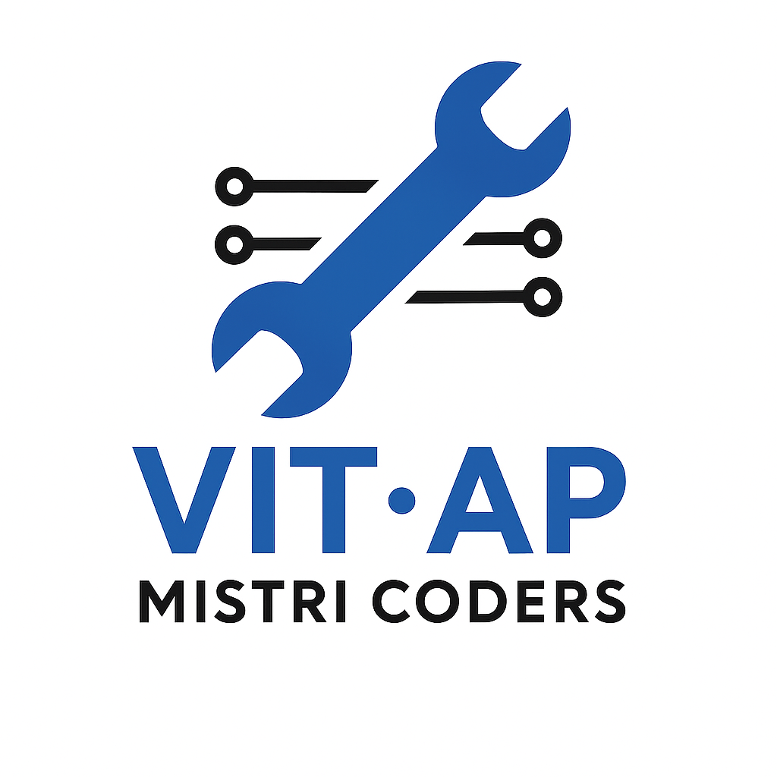

SMART INDIA HACKATHON 2025
Problem Statement ID – 25102
Problem Statement Title- AI-Powered risk detection and mentorship system
Theme- Smart Automation
PS Category- Software
Team ID-
Team Name – Mistri coders

Slide 2
Student dropout prediction dashboard
High dropout rates in educational institutions
Lack of proactive identification of at-risk students
Need for AI-driven mentoring and intervention
Requirement of interactive dashboards for decision-making
Problem statement
Student data management (manual & import)
Risk classification engine
AI-generated intervention strategies and Interactive dashboard with KPIs & charts
System overview
Secure login & user authentication

Slide 3

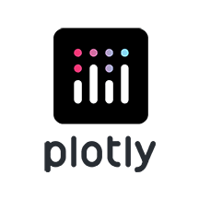



Technical approach
AI & AUDIO INTEGRATION
DistilGPT2 generates personalized mentor interventions
Interventions consider attendance, GPA, fee status, etc.
pyttsx3 converts AI text into speech
Students can listen to interventions as audio
Libraries :
Data Storage: In-memory (St. Session state)
Caching: AI model & TTS engine
Visualization: Interactive charts & tables
Error Handling: Missing columns, numeric type consistency

Slide 4
System Architecture
Security and scalability
Login/Signup/Forgot Password
Data Collection (manual input, CSV/Excel import)
Risk Engine (attendance & score thresholds)
AI Mentor notes with audio playback
Dashboard (KPIs, charts, reports)
Basic login authentication (username/password)
Session management via Streamlit
Extensible: Add fields, swap AI models, extend risk logic
Key features
Authentication: Login, Signup, Forgot Password
Dashboard: Overview, Students, Alerts, Thresholds, Developer Notes
Risk Assessment: Low / Medium / High risk computation
AI Automation: GPT-2 intervention plans, TTS audio output
Student Management: Manual entry, CSV/Excel import, data merge

Slide 5
Impacts and benefits
Benefits
Target Users
Future Enhancements
Early detection of potential dropouts
Personalized AI-driven mentoring
Better student engagement & support
Data-driven decision making for institutions
Student Counsellors: Identify at-risk students
Academic Managers: Oversee risk trends
Administrative Staff: Manage student data
Academic Mentors: Monitor & intervene with students
Database-backed persistent storage
Role-based access control
Real-time notifications for high-risk students
Historical trend analysis
Advanced AI models for interventions
The Student Dropout Prediction Dashboard combines AI, data visualization, and risk analytics to proactively identify at-risk students and provide timely interventions. It empowers institutions to reduce dropout rates and improve student success
Conclusion

Slide 6
Summary
• Interactive Dashboard: Overview & student-level insights
• Risk Engine: Configurable thresholds & AI-assisted interventions
• Data Management: Manual entry & bulk import
• Visually Engaging: Animations, charts, radar plots
Research papers, articles, websites related to AI in education
References
6
-Thank You

